Slide 1
ENSF 607 Lab 4
Nick Nikolov
Andrew Lee
Tahmid Kazi
Romil Dhagat​

Slide 2
Input Variables
Number of Tickets: 1000
Start date: 2023-01-01
End date: 2023-06-30
Duration: 6 months
Power BI was used to generate the following graphs/dashboard

Slide 3
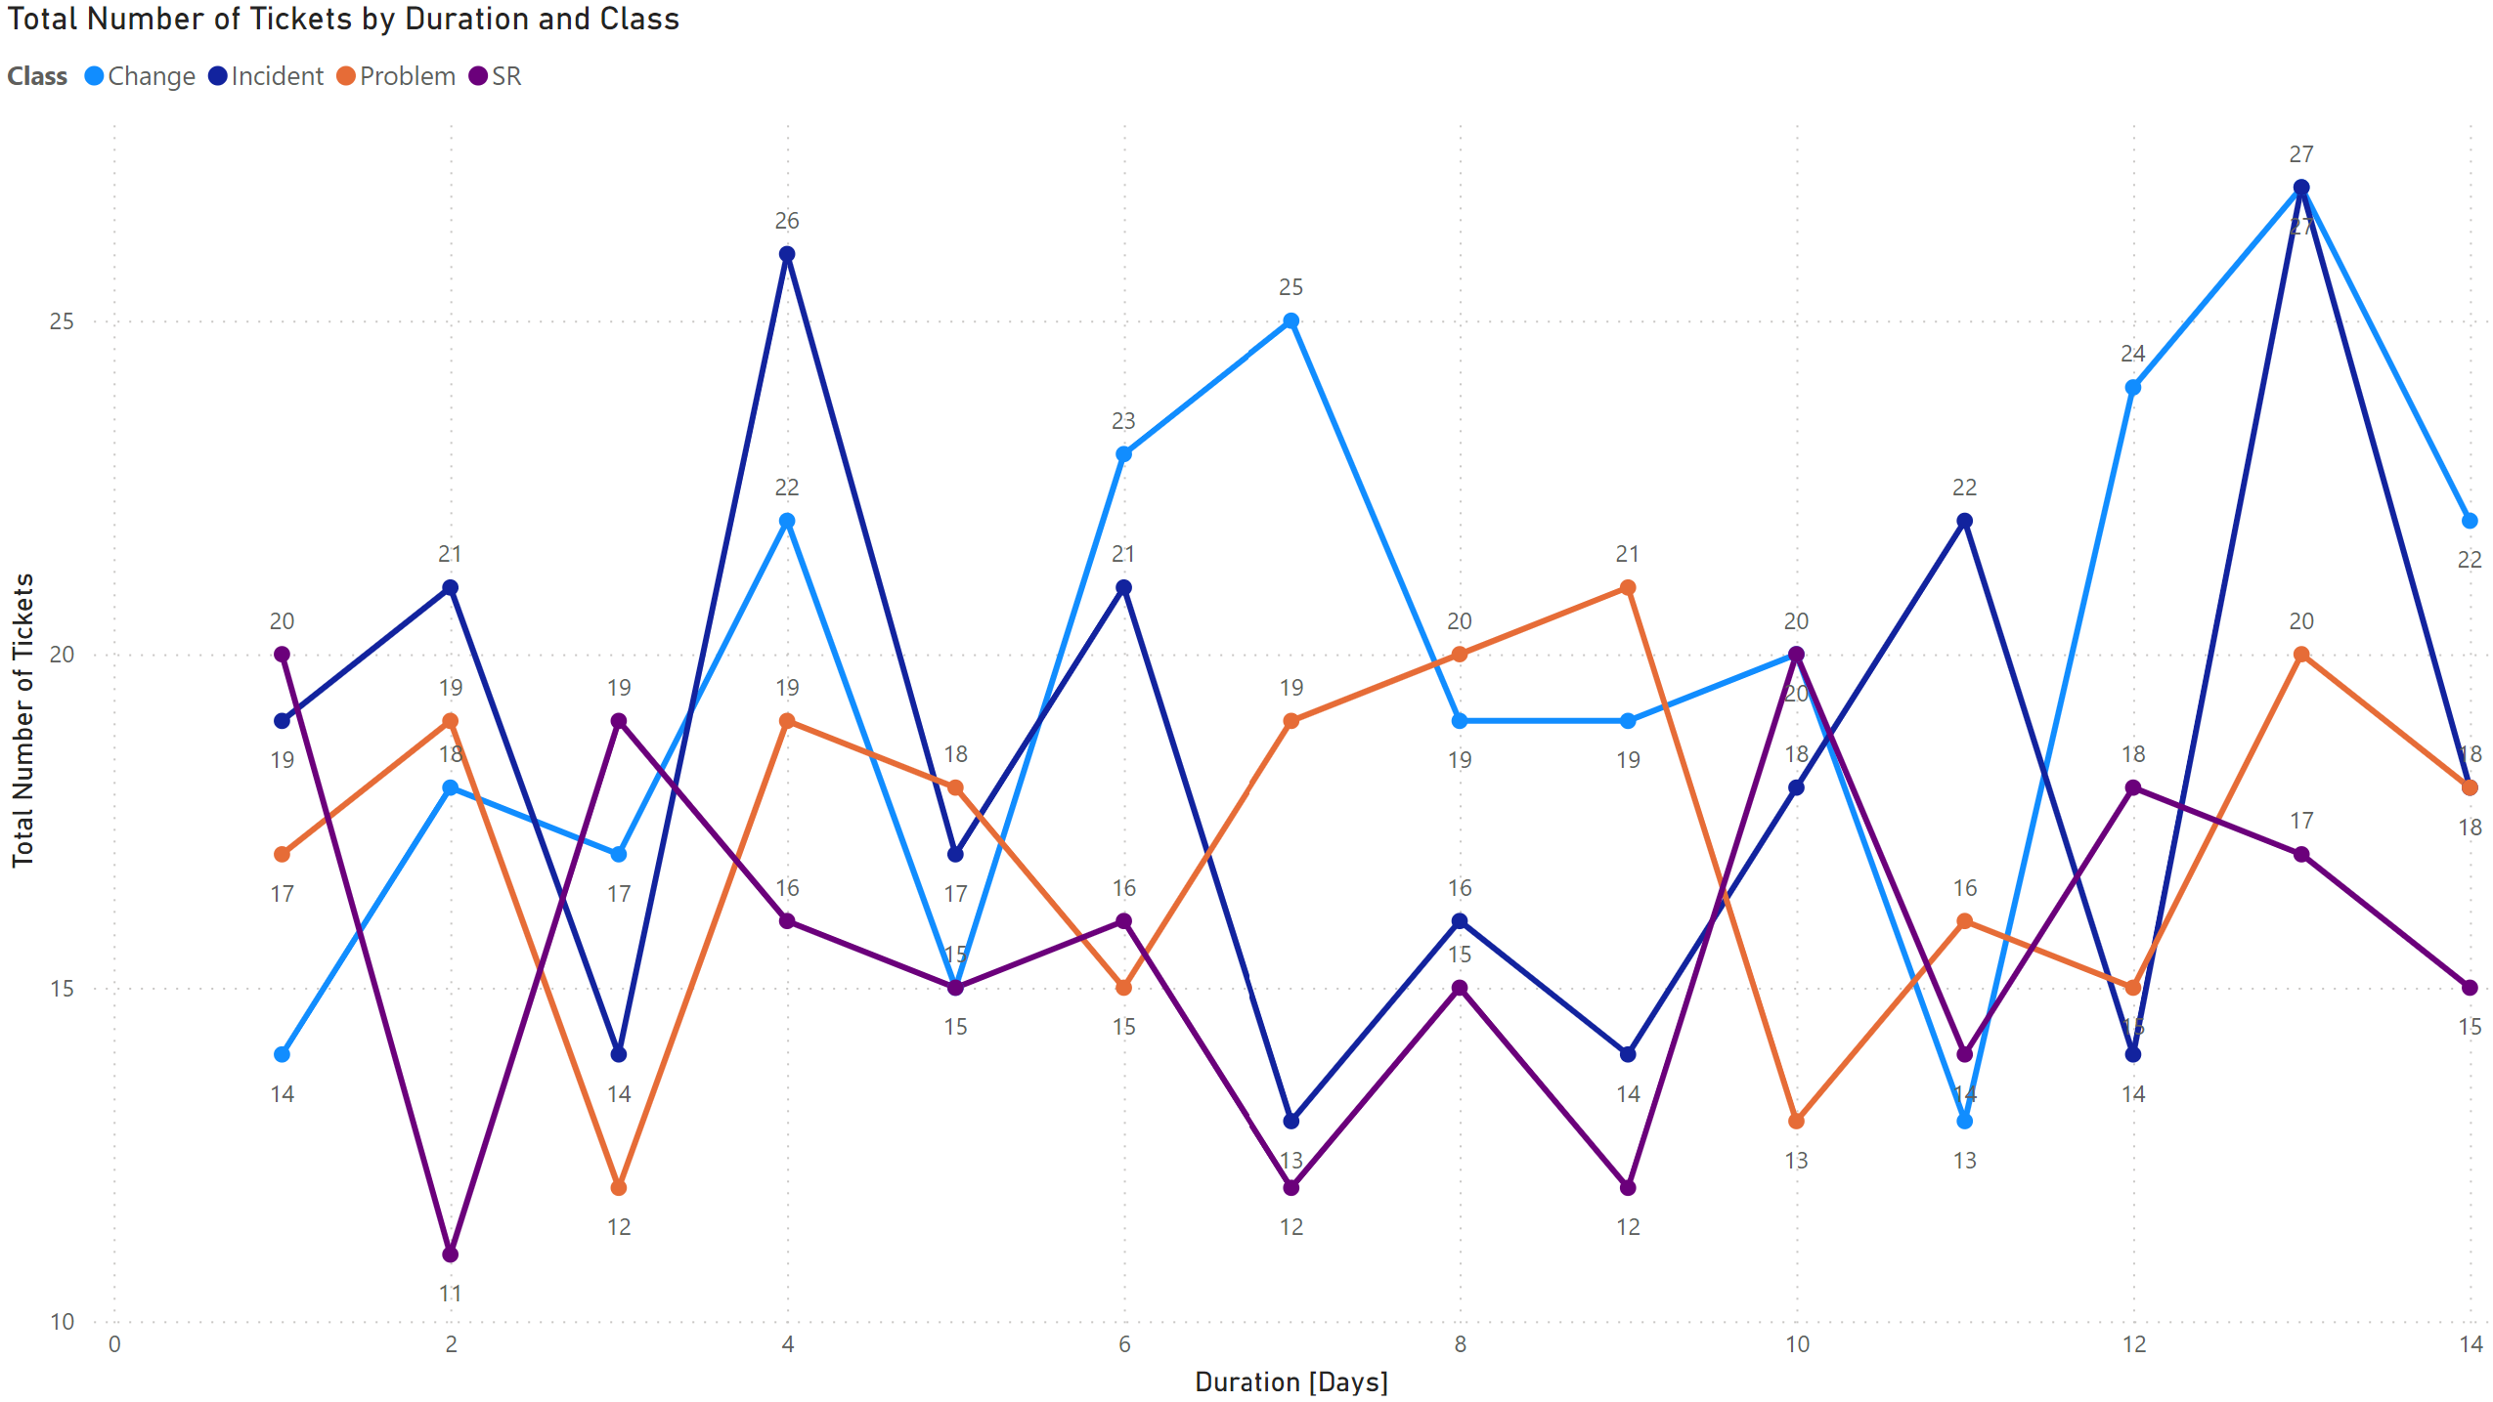
# of tickets by duration and class
X-axis : Duration
Y-Axis : Tickets
Lines designate class
Key takeaway:
Tickets of class Change and Incident have the greatest number of tickets and take the most time to solve

Slide 4
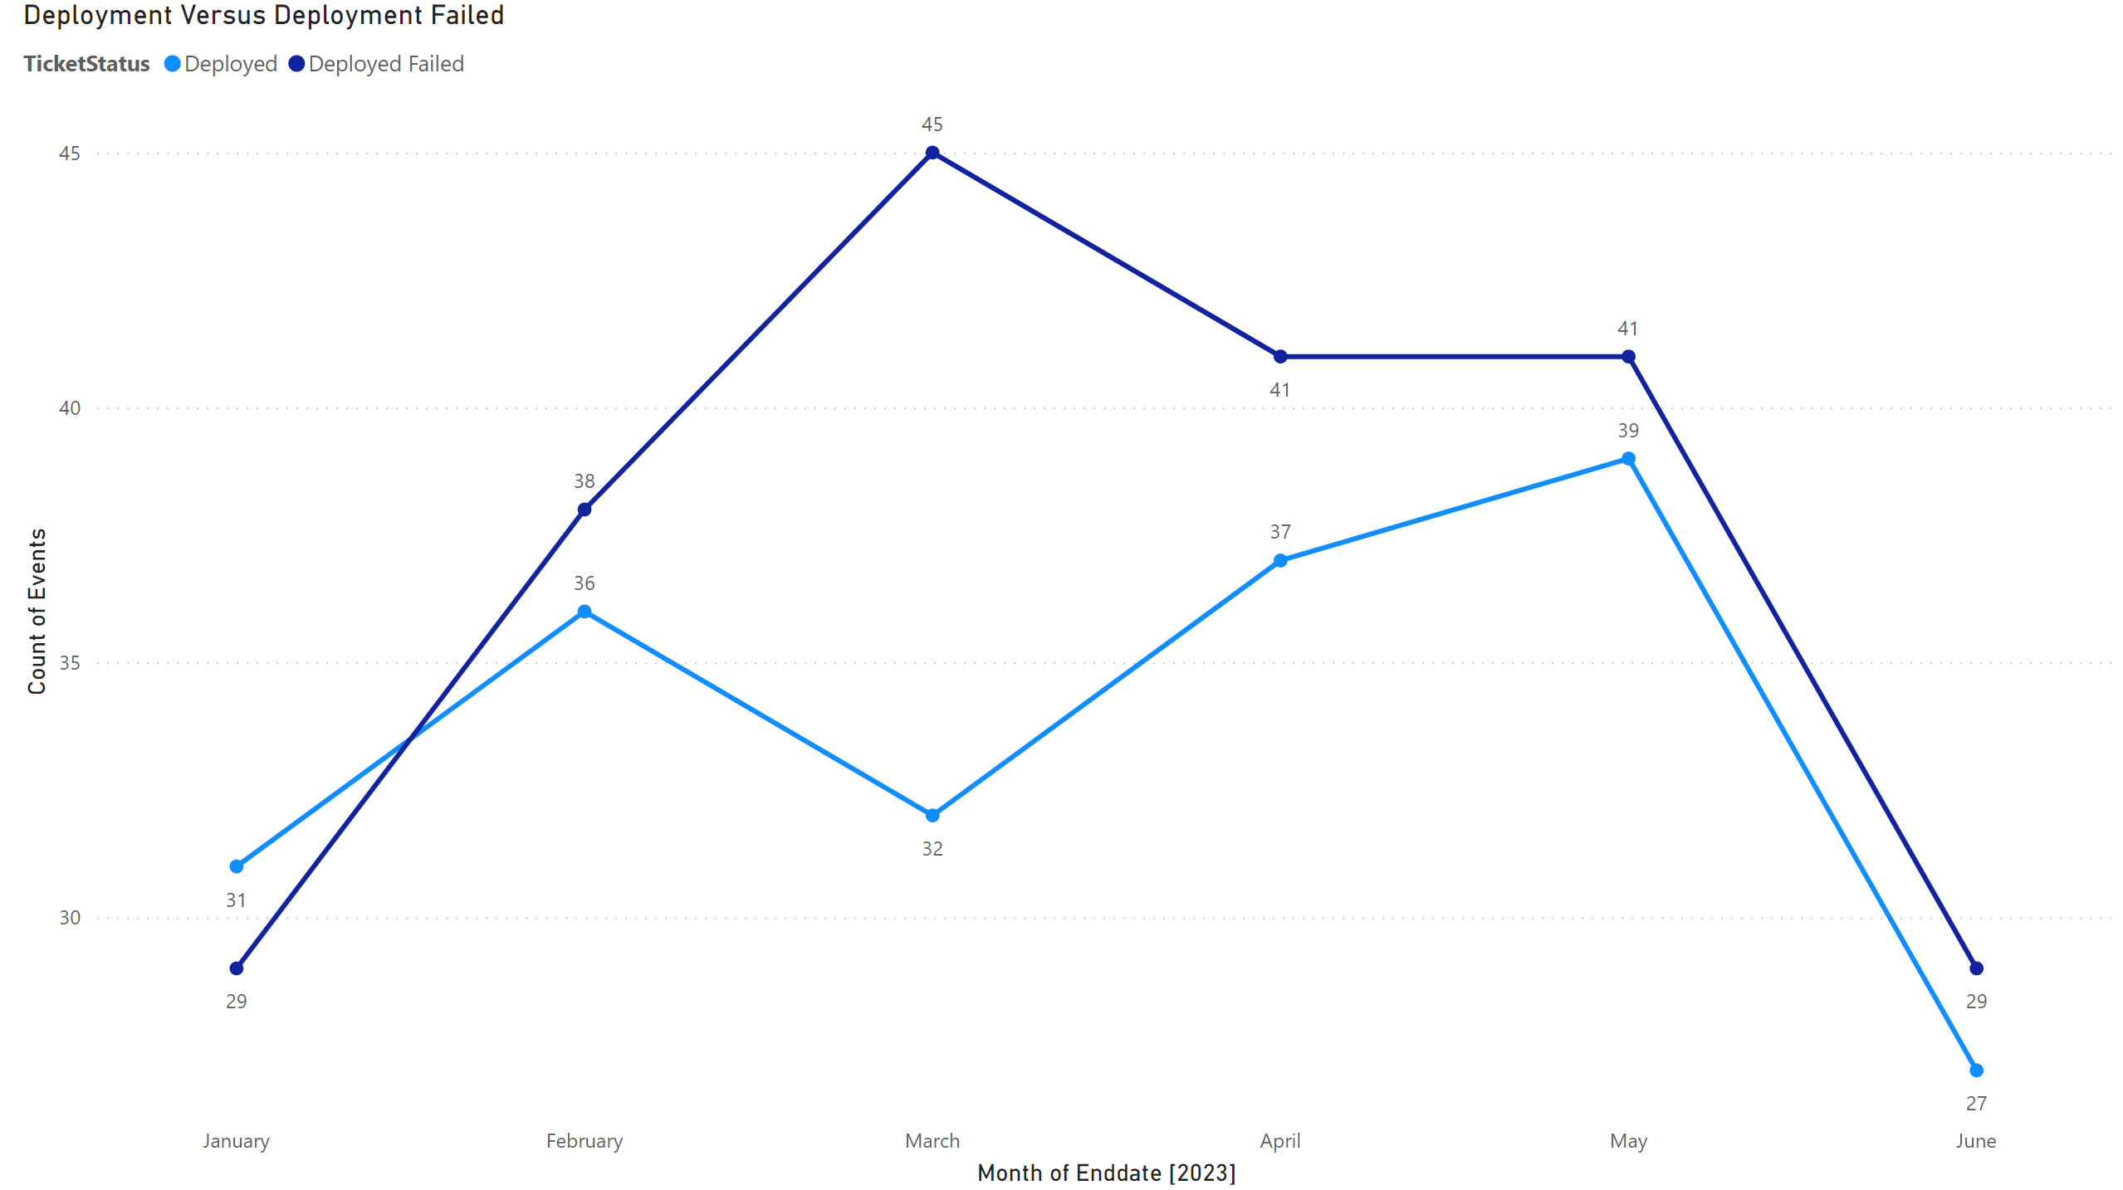
Deployment vs. deployment failed
X-Axis : End date by month
Y-Axis : Number of tickets, that were deployed or deployed failed
Key takeaway:
A greater number of tickets deployed failed than deployed successfully
The month of march saw the greatest discrepancy between failed deployments and successfully deployments

Slide 5
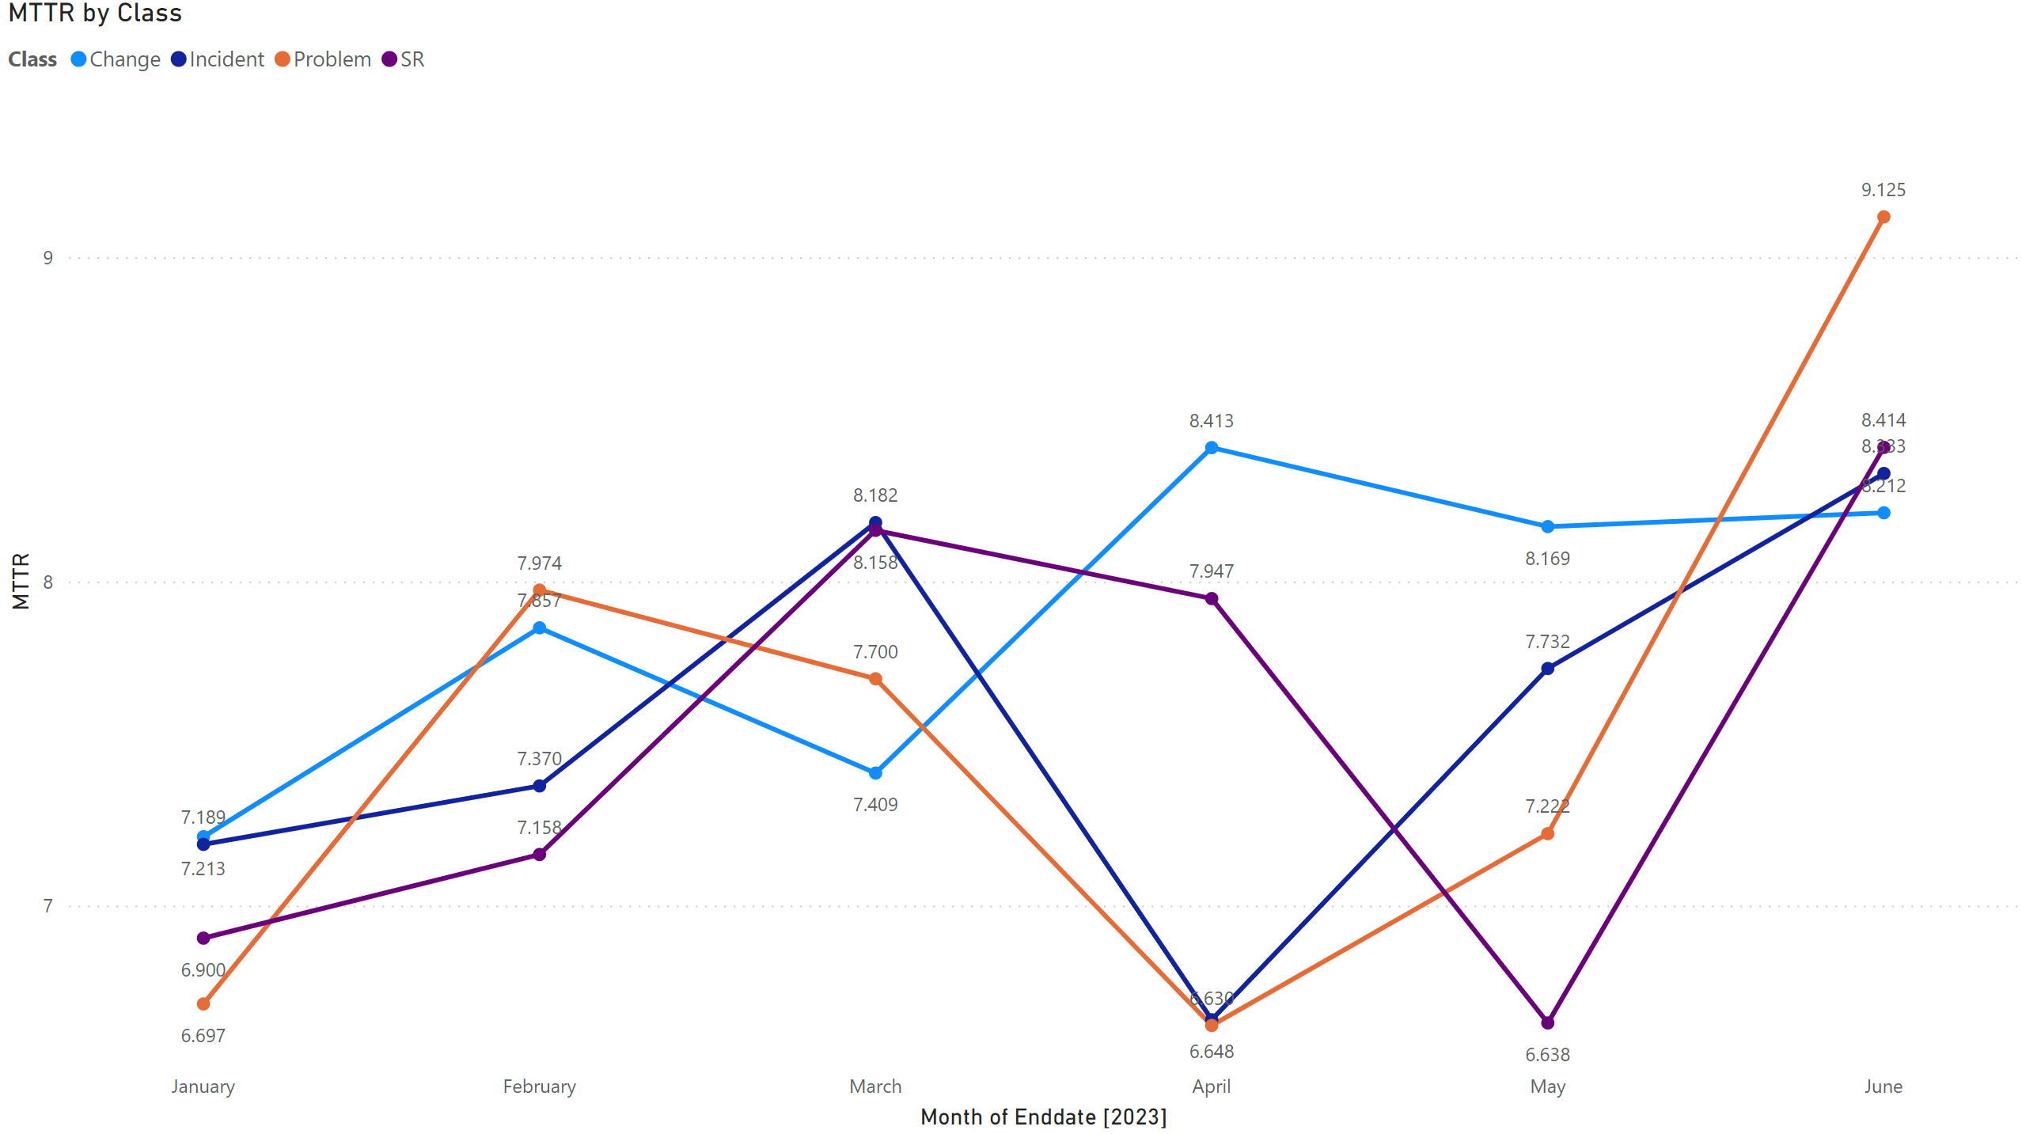
MTTR by EndDate
X-Axis : Time
Y-Axis : MTTR, separated by class
Key takeaway:
MTTR increases as we reduce the number of tickets, that is why we see a spike towards the end.

Slide 6
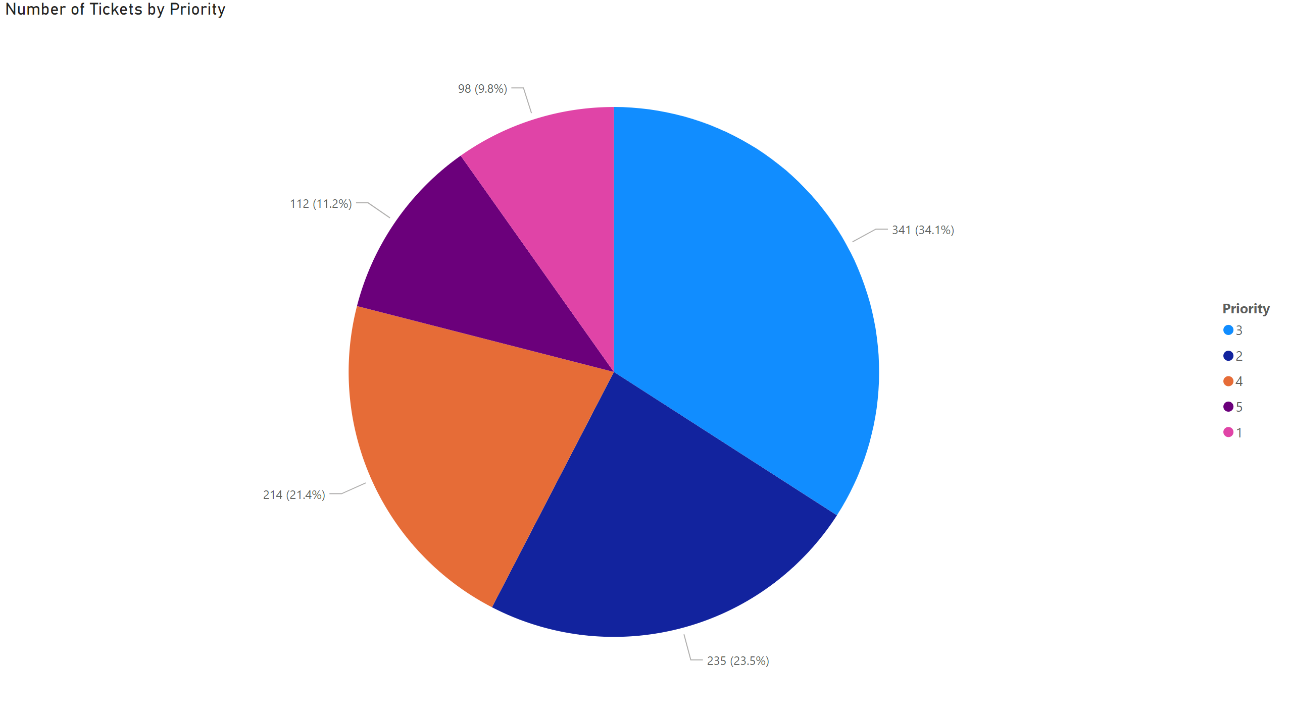
Pie chart
This pie chart depicts the numbers of tickets and what priority they were given.
We can see most tickets were priority level 3 and priority level 1 has the least number of tickets
Over 70% of tickets generated had medium priority levels (2-4)

Slide 7
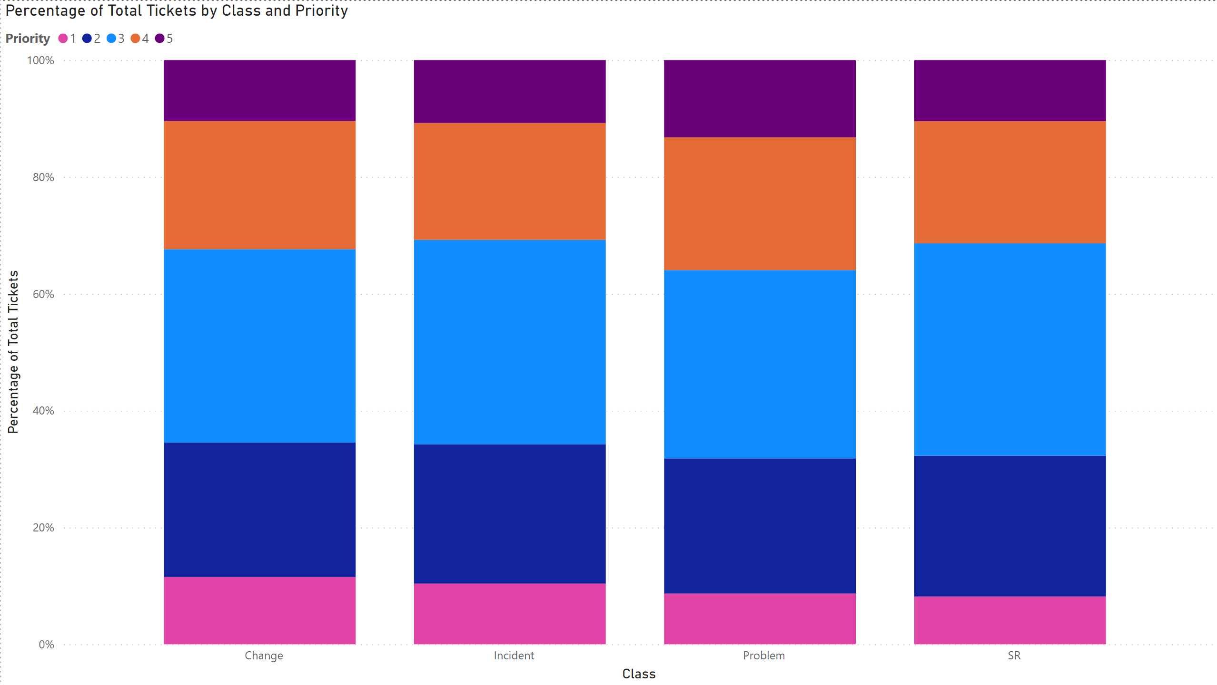
Bar Chart
X-Axis : Class
Y-Axis : Priority % of tickets
From this dashboard we can see that the classes has a mostly even split of priorities per class.
Most tickets generated were priority level three

Slide 8
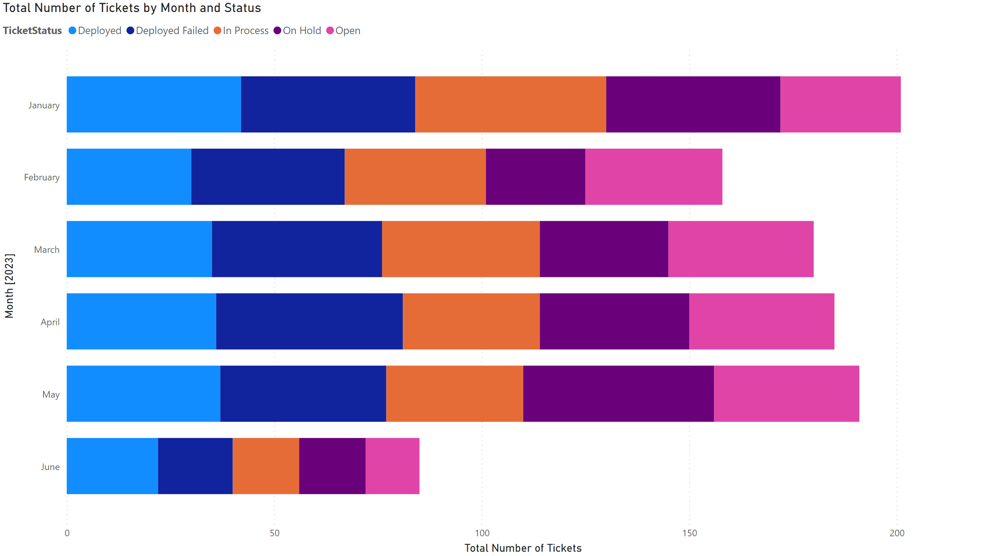
Total number of tickets by month and status
X-Axis: Total number of tickets
Y-Axis: Months, split by status
Key Takeaways:
June had the least number of tickets, possibly due to how the tickets were generated
January had the greatest number of tickets followed by February which had drop in the number of tickets, we can assume that the successful deployments may have had a impact.

